Slide 1
Create a Canvas App in Power Apps

Slide 2
What is Microsoft Dataverse?
Note
Effective November 2020:
Common Data Service has been renamed to Microsoft Dataverse. Learn more
Some terminology in Microsoft Dataverse has been updated. For example, entity is now table and field is now column. Learn more

Slide 3

Agenda
Get started with Power Apps
Customize a canvas app in Power Apps
Manage apps in Power Apps
Navigation in a canvas app in Power Apps
How to build the UI in a canvas app in Power Apps
Use and understand Controls in a canvas app in Power Apps
Document and test your Power Apps application

Slide 4
Get started with Power Apps
Notes:
We introduced Power Apps in the introduction module and we will navigate ways to build Power Apps next

Slide 5
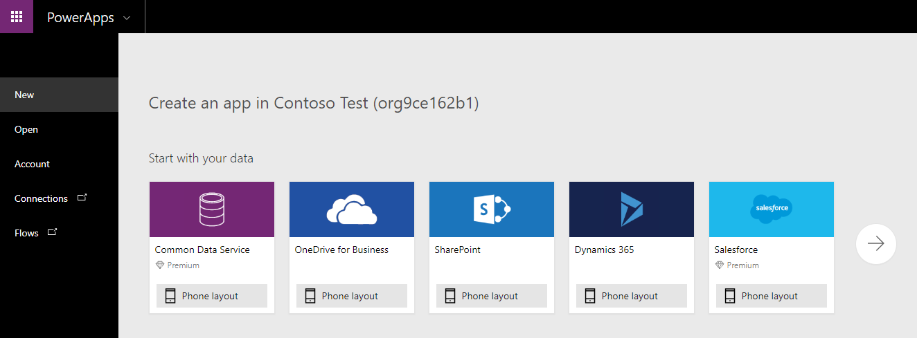
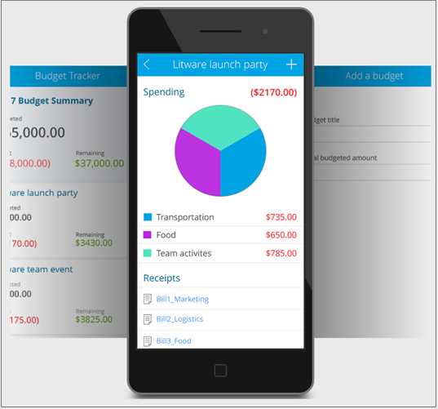
Ways to build Power Apps
There are three primary ways that apps can be created:
From a Template
From a Data Source
From a blank Canvas
Notes:
This unit describes how to create an app from a template, a blank canvas, and a data source. In the next unit, you'll be able to get more hands-on with app creation. This learning path is focused on canvas apps, which give you the flexibility to arrange the user experience and interface the way that you want it. You can get started in many different ways; however, for all of the options, you will use the Power Apps Studio features and functionality to build your app.

Slide 6
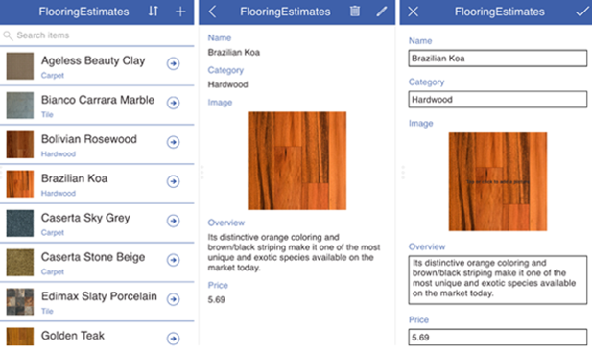
Create an app from a data source
The following app was created from a SharePoint list and lets you browse items in the list, view item details, and create and edit items
Notes:
The following app was created from a SharePoint list and lets you browse items in the list, view item details, and create and edit items. After Power Apps generates an app, you can customize it to make it look and behave exactly the way you want.

Slide 7
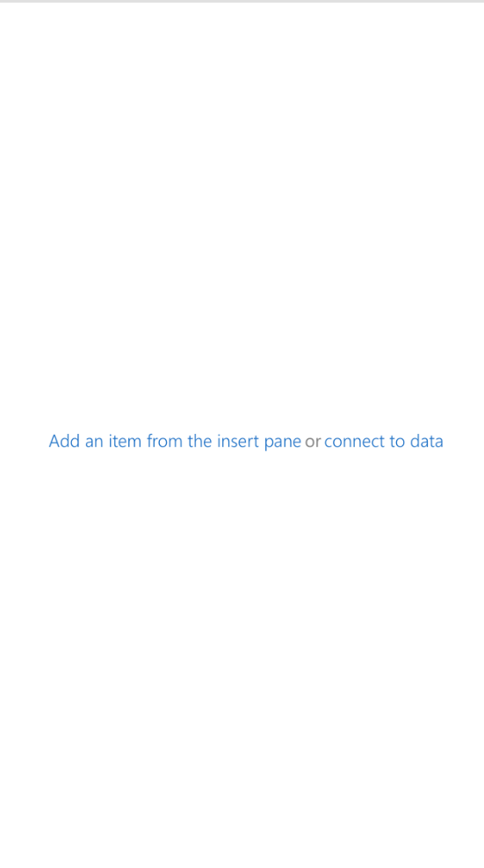
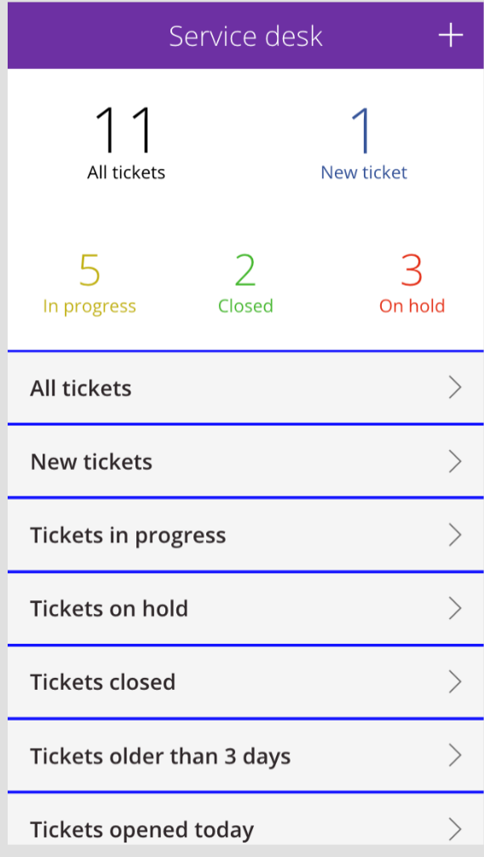
Designing a Power Apps app
As an App Maker, before you begin building your Power Apps solution, it’s recommended to go through a design process
Consider factors such as:
Business requirements
Offline Mode
Data Model
User Experience (UX)
User Interface (UI)
Business Logic
Output
Go from this
To this
Notes:
Learn more to expand the conversation by going here.
https://docs.microsoft.com/en-us/learn/modules/get-started-with-powerapps/4-5-design-app

Slide 8
Exercise: Create your first app in Power Apps
Follow the exercise in the student manual
Notes:
Alternative link
https://docs.microsoft.com/en-us/learn/modules/get-started-with-powerapps/5-powerapps-create-first

Slide 9
Customize a canvas app in Power Apps
Notes:
Demo the first lesson in Module 3 “Customize a canvas app”
Alternative link:
https://docs.microsoft.com/en-us/learn/modules/customize-apps-in-powerapps/1-improve-apps-with-customization

Slide 10
Customize a canvas app in Power Apps
Demo
Notes:
Demo this lesson from the app in the first lesson in Module 3 “Customize a canvas app”
Alternative link:
https://docs.microsoft.com/en-us/learn/modules/customize-apps-in-powerapps/1-improve-apps-with-customization

Slide 11
Controls in Power Apps
UI elements that produces an action or shows information
Common controls include:
Galleries:
Layout containers that hold a set of controls that show records from a data source
Forms:
Show details about your data and let you create and edit records
Media:
Lets you add background images, include a camera button, a barcode reader, and more
Charts:
Add charts so that users can perform instant analysis while they’re on the road
Notes:
A control is a UI element that produces an action or shows information. Many controls in Power Apps are similar to controls that you've used in other apps: labels, text-input boxes, drop-down lists, navigation elements, and so on.
In addition to these typical controls, Power Apps has more specialized controls, which you can find on the Insert tab.
A few controls that can add interest and impact to your apps include:
Galleries - These controls are layout containers that hold a set of controls that show records from a data source.
Forms - These controls show details about your data and let you create and edit records.
Media - These controls let you add background images, include a camera button (so that users can take pictures from the app), a barcode reader for quickly capturing identification information, and more.
Charts - These controls let you add charts so that users can perform instant analysis while they're on the road.
To see what controls are available, select the Insert tab, and then select each option in turn.
Demo before exercise

Slide 12
Explore screens and controls in Power Apps
Demo
Notes:
Demo Module 3 lesson 2 “Explore screens and controls in Power Apps”
Alternative link
https://docs.microsoft.com/en-us/learn/modules/customize-apps-in-powerapps/2-explore-screens-and-controls

Slide 13
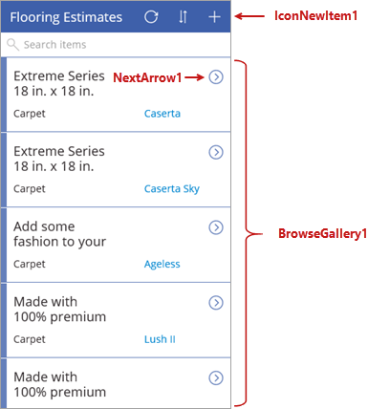
Using controls: Browse screen
BrowseGallery1:
Gallery control that is displaying a list of records from your data source
NextArrow1:
Icon button that when selected, has a formula that opens the details screen
IconNewItem1:
Icon button that when selected, has a formula that opens the edit/create screen
Notes:
Each screen in the app has multiple controls, but one control takes up most of the screen space. The first screen in the app is the browse screen, which is named BrowseScreen1 by default.
Controls in the browse screen that you'll want to become familiar with include:
BrowseGallery1 - This control takes up most of the screen and shows data from your data source.
NextArrow1 - When this control is selected, it opens the details screen.
IconNewItem1 - When this control is selected, it opens the edit/create screen.

Slide 14
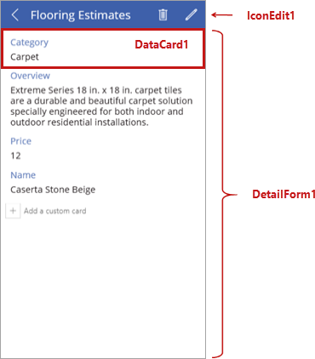
Using controls: Details screen
DetailForm1:
Contains other controls and a data card for each field of the record that is being displayed
DataCard1:
Card control that represents a single field of the record
IconEdit1:
Icon control that when selected, opens the edit/create screen so that the user can edit the current item
Notes:
The details screen is named DetailScreen1 by default. Some of its controls are as follows:
DetailForm1 - This control contains other controls and contains a data card for each field of the record that is being displayed.
DataCard1 - This is a card control. Each card represents a single field of the record. In this case, it shows a flooring category from the Flooring Estimates table, as shown in the previous unit.
IconEdit1 - When this control is selected, it opens the edit/create screen so that the user can edit the current item.

Slide 15
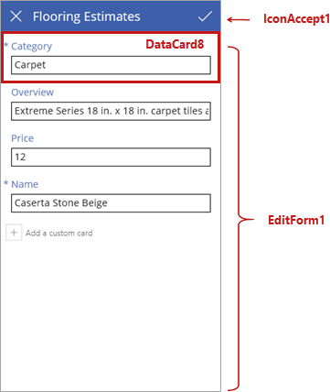
Using controls: Details screen
EditForm1:
Form control contains other controls data card for each field of the record that is being edited
DataCard8:
Card control that shows a flooring category from the Flooring Estimates table, as shown in the previous unit
IconAccept1:
When this control is selected, it saves the user’s changes
Notes:
The third screen in the app is EditScreen1. Some of its controls include:
EditForm1 - This control contains other controls and contains a data card for each field of the record that is being edited.
DataCard8 - This is another card control that shows a flooring category from the Flooring Estimates table, as shown in the previous unit.
IconAccept1 - When this control is selected, it saves the user's changes.

Slide 16
Exercise: Get started with functions in Power Apps
Follow the exercise in the student manual
Notes:
Alternative link
https://docs.microsoft.com/en-us/learn/modules/customize-apps-in-powerapps/3-get-started-with-functions

Slide 17

Manage apps in Power Apps
Notes:
Link: https://docs.microsoft.com/en-us/learn/modules/powerapps-manage/

Slide 18
Managing Power Apps
Each canvas app has multiple management options available including:
Version Management
Sharing apps with other users
Managing environments
Notes:
Potential Instructor demo: https://docs.microsoft.com/en-us/powerapps/maker/canvas-apps/create-component#create-an-example-component

Slide 19
Exercise: Manage app versions
Follow the exercise in the student manual
Notes:
Link: https://docs.microsoft.com/en-us/learn/modules/powerapps-manage/1-manage-app-versions

Slide 20
Exercise: Share apps in Power Apps
Follow the exercise in the student manual
Notes:
Link: https://docs.microsoft.com/en-us/learn/modules/powerapps-manage/2-share-apps

Slide 21
Exercise: Understand environments
Follow the exercise in the student manual
Notes:
We covered these topics in model-driven apps and we can apply them in canvas apps as well.
Link: https://docs.microsoft.com/en-us/learn/modules/powerapps-manage/3-understand-environments

Slide 22
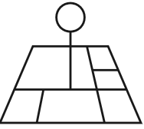
Navigation in canvas app in Power Apps
Notes:
https://docs.microsoft.com/en-us/learn/modules/navigation-canvas-app/

Slide 23
Understanding navigation
Since most apps have multiple screens, understanding how to implement the Navigate function in your app is critical
Typically added to the OnSelect property of a Button or Icon control
Specifies which screen transition effect if any, should be used in the app to navigate to
Navigate(Screen2,ScreenTransition.Cover)
Specifies which screen in the app to navigate to
Notes:
In Power Apps, because most apps have multiple screens, it's essential that you understand how to implement the Navigate function in your app. The Navigate function allows users to move or navigate from screen to screen in an app. For example, if you create an app with three screens and you want to give users a way to navigate to another screen, set the OnSelect property of a Button control to:
Navigate(Screen2,ScreenTransition.Cover)
With this formula, when the button is selected, Screen2 will automatically display. You could also use this formula on an icon, like an arrow, to provide navigation in the app.
The Navigate function also allows for a visual transition as the users move from screen to screen, which is set using ScreenTransition. In the example shown above, ScreenTransition.Cover was applied. There are a few different ScreenTransitions to choose from, and each one provides a slightly different user experience when navigating screens. ScreenTransitions will be covered in further detail later in this module. Similar to the Navigate function, you also have the option to use the Back() function. The Back() function is fairly straight-forward, it sends the user back to the previous screen.
You can use Navigate to set one or more context variables. You can use this approach to pass parameters to a screen. If you've used another programming tool, this is similar to passing parameters to procedures.

Slide 24
Screen transitions
ScreenTransition.Cover – New screen slides into view, covering the current screen
ScreenTransition.Fade – Old screen fades away to reveal the new screen
ScreenTransition.None – Old screen is quickly replaced with the new screen
ScreenTransition.UnCover – Old screen slides out of view, uncovering the new screen
Note: The Back() function can be used to users back to the previous screen that they navigated from. This provides greater flexibility over the Navigate Function
Notes:
ScreenTransition.Cover - The new screen slides into view, covering the current screen.
ScreenTransition.Fade - The old screen fades away to reveal the new screen.
ScreenTransition.None - The old screen is quickly replaced with the new screen.
ScreenTransition.UnCover - The old screen slides out of view, uncovering the new screen.
Here are some examples using ScreenTransitions.
The Back () function has an optional argument for ScreenTransition.
Here's a more detailed example using these functions with multiple controls in a common real-world scenario. In many of the apps that you develop, certain screens may have multiple controls allowing users to navigate to different screens depending on the control they select. In the following example, you will create a three screen app to demonstrate the Navigate and Back() functionality.
In Power Apps Studio, create 3 blank screens.
On Screen1, add a Button control and change the Text property to Next.
On Screen2, add two Button controls and change the Text of one button to Next and the other button control to Back.
On Screen3, add a Button control and change the Text property to Back.
On Screen1, set the Next button OnSelect property to Navigate(Screen2,ScreenTransition.Fade).
On Screen2, set the OnSelect property for the Next button to Navigate(Screen3,ScreenTransition.Cover).
Set the OnSelect property for the Back button to Back().
On Screen3, set the OnSelect property for the Back button to Back().
To test this, put the app in Preview or Play mode and navigate through the app as a user would.
In Power Apps Studio, create 3 blank screens.
On Screen1, add a Button control and change the Text property to Next.
On Screen2, add two Button controls and change the Text of one button to Next and the other button control to Back.
On Screen3, add a Button control and change the Text property to Back.
On Screen1, set the Next button OnSelect property to Navigate(Screen2,ScreenTransition.Fade).
On Screen2, set the OnSelect property for the Next button to Navigate(Screen3,ScreenTransition.Cover).
Set the OnSelect property for the Back button to Back().
On Screen3, set the OnSelect property for the Back button to Back().
To test this, put the app in Preview or Play mode and navigate through the app as a user would.
As you select each button, notice the subtle visual transitions of each ScreenTransition. Remember, the Navigate function must include a ScreenTransition. If you tried to write your Navigate function like this, Navigate(Screen2), Power Apps would display a red squiggly line in the formula box indicating that there is an issue with the function as written.

Slide 25
Hidden screens
Allows the creator of the app to add screens but not give users to access those screens
Accomplished by not creating any navigation for users to those screens
Examples:
Documentation screen
Settings screen
Special permissions screen
Notes:
When using the Back() function it should be noted, this will take you back to the previous screen that you navigated from, the key word being "navigated". To elaborate, this does not mean the screen you or the user was just on, you need to use the Navigate function to navigate away from the screen to then use the Back() function to get back there. This can be a little confusing, so here's an example of how this works.
In the previous example there are 3 screens. Update the OnSelect property of the Next button on Screen1 from Navigate(Screen2,ScreenTransition.Cover) to Navigate(Screen3,ScreenTransition.Cover) and the text property to Jump to Screen 3. Now, when the user selects the button, the app will navigate to Screen3. Then when they select the Back button on Screen3, they will navigate back to Screen1 and skip Screen2 entirely. This is by design in Power Apps and is important to concept understand to ensure the navigation in your app is configured properly.
Before moving on to the next section, add one more screen to the example app and rename the screen Documentation. With no Navigation pointing to this screen, it is not accessible to your end users. The purpose of this screen is to give the App creator a location in the app to make notes or add documentation about certain aspects of how the app functions. The App creator can also provide instructions for other editors of the app so they can quickly and easily identify what the previous creator did.
In this simple four screen app example, you can see how easy it is to navigate screens by setting the OnSelect property of a control. There are several additional ways to navigate through your app covered in the next section.

Slide 26
Demo: Use Back and Navigate functions
Demo
Notes:
https://docs.microsoft.com/en-us/learn/modules/navigation-canvas-app/2-navigate-back-function

Slide 27
Exercise: Use Navigate functions
Follow the exercise in the student manual
Notes:
https://docs.microsoft.com/en-us/learn/modules/navigation-canvas-app/3-more-ways-to-use-navigate-function

Slide 28
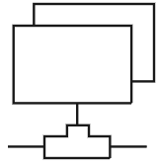
How to build the UI in a canvas app in Power Apps
Notes:
Link: https://docs.microsoft.com/en-us/learn/modules/how-to-build-ui-canvas-app/

Slide 29
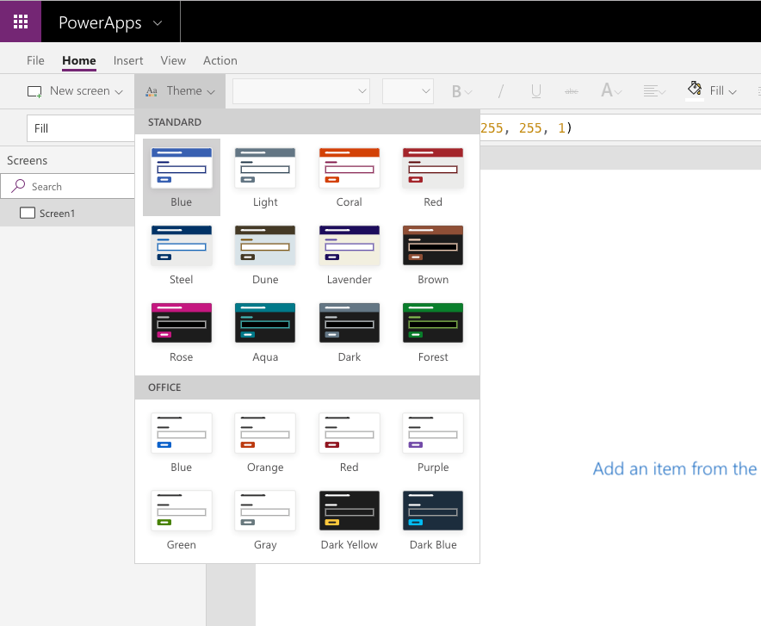
Use themes to quickly change the appearance of your app
A quick and easy way to change the colors in your app is to apply a theme
Notes:
A quick and easy way to change the colors in your app is to apply a theme. In Power Apps, there are several out-of-the-box themes to choose from. The following screenshot illustrates all the themes that are available in your app.
These themes have a specific set of default colors and visual elements which will alter the look and feel of your entire app. To use any of these themes in your Canvas app, select a theme from the ribbon. The changes to your app will take effect immediately.
If none of the included themes work for your app, you can create a custom theme. For example, if you decide to select the Steel theme but want the screen background to be a lighter color, this can be easily done. To change the background of your screen, change the Fill property to RGBA(250, 250, 250, 1). The screen will be a slighter lighter shade of gray. Keep in mind, this only changed the fill of that specific screen, if you want to add a new blank screen it would still have the Fill property of RGBA(232, 232, 232, 1). This is by design when working with a canvas app. Also, there is no option to create a Custom theme for a canvas app and store it to be used for other apps.
Typically, many organizations will select the theme that best suits their needs, and then alter the various control properties to align with their corporate branding.

Slide 30
Branding a control
By adjusting a few of the Control properties, like Fill, Hover, and Border you can completely change how the control looks
Example: Button Control:
Typical Properties: BorderColor, BorderStyle, Color, and Fill
Disabled Properties: DisabledColor, DisabledFill
Hover Properties: HoverColor, HoveFill
These are just some of the properties you can modify, and each control will have different properties available
Notes:
As noted earlier, one of the built-in themes may not match your organizations desired look and feel for the app. You can customize your app by changing various properties of the app controls. By adjusting a few of the Control properties, like Fill, Hover, and Border you can completely change how the control looks. If you decide to customize your controls, it's recommended that you do this thorough testing to ensure that you don't run into any complications when users interact with the app.
For example, consider the Button control. The following are some of the properties of a Button control that you could customize to better fit your companies theme.

Slide 31
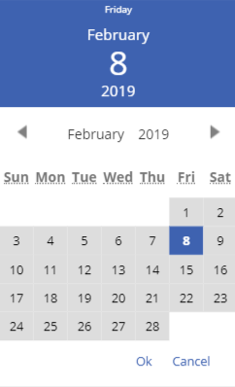
Some color settings are only controlled by the theme
There are certain aspects of controls that cannot be altered and are specific to the theme that you select
Notes:
There are certain aspects of controls that cannot be altered and are specific to the theme that you select. For example, here's an example of the Date picker control.
In Power Apps Studio, add the Date picker control.
Put the app in preview mode and select the control so that it opens.
The color at the top of the Date picker control is specific to the theme, meaning there isn't a control property you can change to set the color manually. To change the color of that background you would have to select a different theme.
In Power Apps Studio, add the Date picker control.
Put the app in preview mode and select the control so that it opens.
The color at the top of the Date picker control is specific to the theme, meaning there isn't a control property you can change to set the color manually. To change the color of that background you would have to select a different theme.
As you design your app, be sure to incorporate the use of icons. In the next section, you'll learn how to add an icon to a Canvas app to change the look and feel of the app.

Slide 32
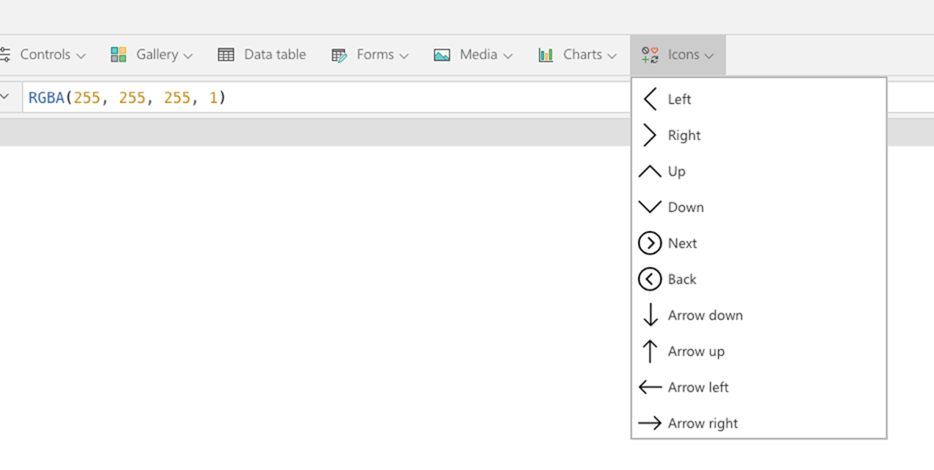
Icons
Shapes and Icon controls are an easy way to enhance the user experience of your app. They include properties like other controls
Icons include:
Arrows
Geometric shapes
Actions
Symbol
Notes:
When designing your app, utilize Shapes and Icon controls when possible to enhance the user experience of your app. There are certain shapes and icons that are universally recognized that you will find in many of the apps that you use daily. For example, instead of adding a Button control to your app and setting the OnSelect property to Back(), you could just as easily use the Back icon control and set it's OnSelect property to Back().
Remember, icons are controls, and each control has a specific set of properties that can be modified to change how the control looks and functions. To view all of available icon controls, select Insert and then select the Icons drop-down menu.
These controls include arrows, geometric shapes, actions, and symbols. By incorporating shapes and icons, you can save some space and reduce clutter in your app, especially when working with a Phone form factor app. The Phone form factor app has a much smaller area for designing and adding controls so replacing some of the buttons with shapes and icons could really benefit the overall spacing of your app.

Slide 33
Images
The Image control is a control that shows an image:
Image:
The name of the image that appears in an image, audio, or microphone control
Image Position:
The position (Fill, Fit, Stretch, Tile, or Center) of the image in a screen or a control if it isn’t the same size as the image
Transparency:
The degree to which the controls behind an image remain visible
Notes:
You can demo this by following the steps here: https://docs.microsoft.com/en-us/learn/modules/how-to-build-ui-canvas-app/4-images
The Image control is a control that shows an image. The image may be from a local file or a data source. Adding an image, such as a company logo is an easy way to enhance the overall look and feel of your app. On each screen you can apply a Background image, as well as multiple Image controls. You're not limited to a certain number of images that you can display; you can have as many images as you would like. Too many images may cause issues with the app performance and load times, but you would have to add quite a few large images for this to be an issue. There are a set of properties specific to the Image control that allow you to customize how the image is displayed. When working with the Image control, a few of the more common properties you will most likely want to modify are the Image, Image position, and Transparency properties.
Image - The name of the image that appears in an image, audio, or microphone control.
Image Position - The position (Fill, Fit, Stretch, Tile, or Center) of the image in a screen or a control if it isn't the same size as the image.
Transparency - The degree to which the controls behind an image remain visible.
Here's a quick example of how to change the transparency and image position of an Image control.
In Power Apps, create a Tablet app using the "Product Showcase" App template.
On the left, under Screens, select Image1.
In the right pane, set the Transparency property to 0.5.
In Power Apps, create a Tablet app using the "Product Showcase" App template.
On the left, under Screens, select Image1.
In the right pane, set the Transparency property to 0.5.
You will notice that the image immediately becomes lighter in color.
In the Image position property, change this to Center.
The image appears to be zoomed in or larger.
As you develop your app, keep these settings in mind when using the Image control to enhance the look and feel of your app.

Slide 34
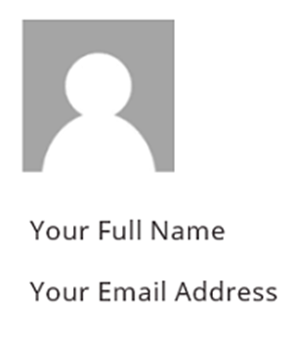
Personalization
User() function returns a record of information about the current user
Property | Description
User().Email | Email address of the current user
Uer().FullName | Full name of the current user, including first and last name
User()Image | Image of the current user. This will be an image URL of the form “blob:identifier”
Notes:
Possible Instructor Led Demo: https://docs.microsoft.com/en-us/learn/modules/how-to-build-ui-canvas-app/5-personalization
In Power Apps, you can show information about the current user with the User() function. This includes the full name, email address, and the picture that's associated with the user who's signed into a canvas app. It will match the "Account" information that is displayed in the Power Apps players and studio, which can be found outside of any authored apps. This may not match the current user's information in Office 365 or other services.
The User function returns a recordof information about the current user:
Set the Image propertyof the Image controlto this value to display the image in the app.
Here's an example of how to add a user's profile picture, email, and name to your app.
On the Insert tab, click or tap Media, and then click or tap Image.
Set the Image property to this formula: User().Image
On the Insert tab, click or tap Text, and then click or tap Label:
Set the Text property to this formula: User().FullName
Move the label so it's below the image control.
Add another label, and set its Text property to this formula: User().Email
Move the label so it's below the first label:
On the Insert tab, click or tap Media, and then click or tap Image.
Set the Image property to this formula: User().Image
On the Insert tab, click or tap Text, and then click or tap Label:
Set the Text property to this formula: User().FullName
Move the label so it's below the image control.
Add another label, and set its Text property to this formula: User().Email
Move the label so it's below the first label:

Slide 35
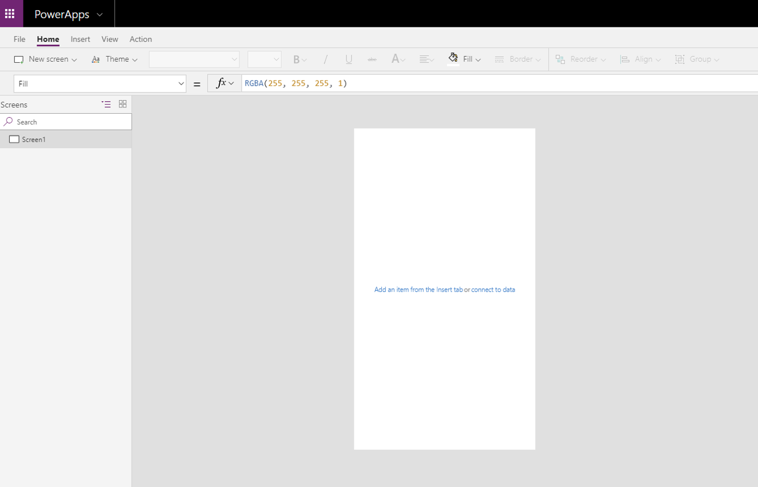
Using the tablet or phone form factors
It is important to design your app for the primary device that it will be used on
Notes:
It is important to design your app for the primary device that it will be used on. There are two form factors to choose from, the Phone form factor and the Tablet form factor. The main difference between these is the Screen size. The screen size affects the amount of space available to build the app.
The Phone form factor has a significantly smaller area to build your app, but if most of your users will be accessing the app from a mobile phone then this is the best form factor for you. When building for mobile, select controls that will be easy to use on a mobile device, ensure that the text is large enough to be easily seen, and design the app in a single column vertical format.
The Tablet form factor has a much larger area for designing your app and is the best option if your users will be accessing the app from a tablet or PC. Because you have more screen size to work with, you will have more flexibility in designing this app. Regardless of the form factor that you choose; the functionality available in the Power Apps Studio will be the same.
Take a moment and create two blank Canvas apps. For one of the apps use the Phone form factor and for the other app use the Tablet form factor. You will immediately notice the difference in the amount of space available on the screen to design your app.
Phone form factor

Slide 36
Using the tablet or phone form factors
App size can be altered based on the form factor will be consumed on. Be sure to select the appropriate size for the majority of your app users
Tablet sizes available:
16:9 (Default)
3:2 (Surface Pro 3)
16:10 (Widescreen)
4:3 (iPad)
Custom
Note: The Phone form factor does not include screen size options
Notes:
Tablet form factor
Depending on the form factor that you choose, you have the ability to alter the screen size. To view the current screen size and orientation, for either form factor, see following steps.
In Power Apps Studio, in the upper-left corner, select File.
On the left, select App settings.
In Power Apps Studio, in the upper-left corner, select File.
On the left, select App settings.
When you are in the tablet app, you will notice multiple options to select from for the screen size. Be sure to select the appropriate size for the majority of your app users.
16:9 (Default)
3:2 (Surface Pro 3)
16:10 (Widescreen)
4:3 (iPad)
Custom
16:9 (Default)
3:2 (Surface Pro 3)
16:10 (Widescreen)
4:3 (iPad)
Custom
The Phone form factor does not include screen size options.

Slide 37
Use and understand controls in a canvas app in Power Apps

Slide 38
Controls in Power Apps
UI elements that produces an action or shows information
Common controls include:
Galleries:
Layout containers that hold a set of controls that show records from a data source
Forms:
Show details about your data and let you create and edit records
Media:
Lets you add background images, include a camera button, a barcode reader, and more
Charts:
Add charts so that users can perform instant analysis while they’re on the road
Notes:
A control is a UI element that produces an action or shows information. Many controls in Power Apps are similar to controls that you've used in other apps: labels, text-input boxes, drop-down lists, navigation elements, and so on.
In addition to these typical controls, Power Apps has more specialized controls, which you can find on the Insert tab.
A few controls that can add interest and impact to your apps include:
Galleries - These controls are layout containers that hold a set of controls that show records from a data source.
Forms - These controls show details about your data and let you create and edit records.
Media - These controls let you add background images, include a camera button (so that users can take pictures from the app), a barcode reader for quickly capturing identification information, and more.
Charts - These controls let you add charts so that users can perform instant analysis while they're on the road.
To see what controls are available, select the Insert tab, and then select each option in turn.

Slide 39
Core properties of controls
While each control may have slightly different properties the following are important ones to be aware of:
Default: Initial value of control before it is changed by the user
Items: The source of data that appears in a control such as a gallery, list, or chart
OnChange: How the app responds when the user changes the value of a control. For example, when a user selects a different value in a Dropdown control
OnSelect: How the app responds when the user taps or clicks a control
Text: Text that appears on a control or that the user types into a control
Tooltip: Explanatory text that appears when the user hovers over a control
Visible: Whether a control appears or is hidden
Notes:
Because controls are designed with specific use cases in mind, the properties for each control are slightly different. Here are some important properties to be aware of:
Default - The initial value of a control before it is changed by the user. For example, when working with a Drop down control you could set the default value to appear when users see the control.
DelayOutput - Set to true to delay action during text input.
DisplayMode - Values can be Edit, View, or Disabled. Configures whether the control allows user input (Edit), only displays data (View), or is disabled (Disabled). For more information about display modes, see Use basic formulas to make better canvas apps in Power Apps learning path.
Items - The source of data that appears in a control such as a gallery, list, or chart.
OnChange - How the app responds when the user changes the value of a control. For example, when a user selects a different value in a Dropdown control.
OnSelect - How the app responds when the user taps or clicks a control.
Reset - Whether a control reverts to its default value. For more information, see Reset function in Power Apps.
Text - Text that appears on a control or that the user types into a control.
Tooltip - Explanatory text that appears when the user hovers over a control.
Visible - Whether a control appears or is hidden.
Default - The initial value of a control before it is changed by the user. For example, when working with a Drop down control you could set the default value to appear when users see the control.
DelayOutput - Set to true to delay action during text input.
DisplayMode - Values can be Edit, View, or Disabled. Configures whether the control allows user input (Edit), only displays data (View), or is disabled (Disabled). For more information about display modes, see Use basic formulas to make better canvas apps in Power Apps learning path.
Items - The source of data that appears in a control such as a gallery, list, or chart.
OnChange - How the app responds when the user changes the value of a control. For example, when a user selects a different value in a Dropdown control.
OnSelect - How the app responds when the user taps or clicks a control.
Reset - Whether a control reverts to its default value. For more information, see Reset function in Power Apps.
Text - Text that appears on a control or that the user types into a control.
Tooltip - Explanatory text that appears when the user hovers over a control.
Visible - Whether a control appears or is hidden.
To view a list of all the controls and their properties, see Controls and properties in Power Apps.

Slide 40
Entering and displaying data with text controls
Text controls are used for all kinds of purposes, such as displaying text, numbers, dates, and calculating currency
Available text controls:
Label:
A label shows data that you specify as a literal string of text, which appears exactly the way you type it, or as a formula that evaluates to a string of text
Text input:
A box in which the user can type text, numbers, and other data
HTML text:
An HTML text control not only shows plain text and numbers but also converts HTML tags, such as non-breaking spaces
Rich text editor:
The rich text editor control provides the app user a WYSIWYG editing area for formatting text
Pen input:
A control in which the user can draw, erase, and highlight areas of an image
Notes:
In Power Apps, text controls are used for all kinds of purposes, such as displaying text, numbers, dates, and calculating currency. For example, you could calculate the value of two Text input controls and display the results in a Label control.
There are several text controls that you could incorporate into your app. Each of these controls have slightly different purposes and use cases. For example, maybe you're creating an employee survey app, and you want to get employee feedback. In this scenario, you would use the Text input control and modify the Mode property to be Multiline instead of single line. Most likely, every app that you work with will have text controls so familiarizing yourself with these controls will be helpful as you develop your app. The follow list details the different text controls that are available.
Label - A label shows data that you specify as a literal string of text, which appears exactly the way you type it, or as a formula that evaluates to a string of text. Labels often appear outside of any other control (such as a banner that identifies a screen), as a label that identifies another control (such as a rating or audio control), or in a gallery to show a specific type of information about an item.
Text input - A box in which the user can type text, numbers, and other data. For example, a user can specify data by simply typing in a text input control. Depending on how you configure the app, that data might be added to a data source, used to calculate a temporary value, or incorporated in some other way.
HTML text - An HTML text control not only shows plain text and numbers but also converts HTML tags, such as non-breaking spaces.
Rich text editor - The rich text editor control provides the app user a WYSIWYG editing area for formatting text. This control should be used if you want to allow the user to provide numbered lists or bullet lists. A good example is a Power Apps app that used to collect content for an article or newsletter, where you allow the user to add formatted text that would be helpful for the person compiling the article.
Pen input - A control in which the user can draw, erase, and highlight areas of an image. The user can use this control like a whiteboard, drawing diagrams and writing words that can be converted to typed text.
Label - A label shows data that you specify as a literal string of text, which appears exactly the way you type it, or as a formula that evaluates to a string of text. Labels often appear outside of any other control (such as a banner that identifies a screen), as a label that identifies another control (such as a rating or audio control), or in a gallery to show a specific type of information about an item.
Text input - A box in which the user can type text, numbers, and other data. For example, a user can specify data by simply typing in a text input control. Depending on how you configure the app, that data might be added to a data source, used to calculate a temporary value, or incorporated in some other way.
HTML text - An HTML text control not only shows plain text and numbers but also converts HTML tags, such as non-breaking spaces.
Rich text editor - The rich text editor control provides the app user a WYSIWYG editing area for formatting text. This control should be used if you want to allow the user to provide numbered lists or bullet lists. A good example is a Power Apps app that used to collect content for an article or newsletter, where you allow the user to add formatted text that would be helpful for the person compiling the article.
Pen input - A control in which the user can draw, erase, and highlight areas of an image. The user can use this control like a whiteboard, drawing diagrams and writing words that can be converted to typed text.
Here's a closer look at the Label control and a few examples so you can get a better idea as to how it works.
First, add a label control to show text.
In Power Apps Studio, add a Label control.
Set Text property for the Label to "Hello, world" (including the double quotation marks).
In Power Apps Studio, add a Label control.
Set Text property for the Label to "Hello, world" (including the double quotation marks).
Next, create a more dynamic solution by combining a button, gallery, and multiple label controls. In this scenario, you'll create a collection called CityPopulations that contains data about the population of various cities in Europe. Next, you'll show that data in a gallery that contains three labels, and you'll specify the type of data that each label will show.
Add a button, and set its OnSelect property to this formula:
Press and hold Alt Key, and select the Button control. (This will create your collection and store all the information.)
Add a Blank vertical gallery and set its Items property to CityPopulations.
With the gallery selected, in the right pane, change the layout from blank to Title, subtitle, and body.
Select the top or first Label, in the Text property the default for example shows ThisItem.City, you could change this to something else if you would like. For more information about the ThisItem operator, see Operators and data types in Power Apps.
Select the middle or second Label, which shows as ThisItem.Country.
Select the last or third Label, change the Text property to ThisItem.Population.
Press and hold Alt Key, and select the Button control. (This will create your collection and store all the information.)
Add a Blank vertical gallery and set its Items property to CityPopulations.
With the gallery selected, in the right pane, change the layout from blank to Title, subtitle, and body.
Select the top or first Label, in the Text property the default for example shows ThisItem.City, you could change this to something else if you would like. For more information about the ThisItem operator, see Operators and data types in Power Apps.
Select the middle or second Label, which shows as ThisItem.Country.
Select the last or third Label, change the Text property to ThisItem.Population.
These were just two simple examples demonstrating some basic functionality of a label control. There are many other ways to utilize label controls in your app.

Slide 41
Demo: Text controls
Demo
Notes:
https://docs.microsoft.com/en-us/learn/modules/controls-canvas-apps/3-text-controls

Slide 42
Controls with pre-populated values
Drop down: Helps conserve screen real estate. The control takes up only one line unless the user selects the chevron to reveal more choices. It can show a maximum of 500 items
Combo box: Allows you to search for items you will select. The search is performed on the server on the SearchField property so performance is not affected by very large data sources
List box: Always shows all available choices (unlike a Dropdowncontrol) and in which the user can choose more than one item at a time (unlike a Radiocontrol)
Check box: Control that the user can select or clear to set its value to true or false. The user can specify a Boolean value by using this familiar control
Radio: A Radio control, a standard HTML input control, is best used with only a few, mutually-exclusive options
Notes:
Each of these controls allows you to determine the values the user can select from. Use these controls when you want to control the values for your data set. This is often an important consideration for reporting. As a trade-off, you may miss valuable insights that come from free form answers. Here's a closer look at the differences between each of these controls.
Drop down - This control conserves screen real estate, especially when the list contains a large number of choices. The control takes up only one line unless the user selects the chevron to reveal more choices. This control will show a maximum of 500 items.
Combo box - This control allows you to search for items you will select. The search is performed on the server on the SearchField property so performance is not affected by very large data sources.
List box - This control always shows all available choices (unlike a Dropdowncontrol) and in which the user can choose more than one item at a time (unlike a Radiocontrol).
Check box - A control that the user can select or clear to set its value to true or false. The user can specify a Boolean value by using this familiar control.
Radio - A Radio control, a standard HTML input control, is best used with only a few, mutually-exclusive options.
Drop down - This control conserves screen real estate, especially when the list contains a large number of choices. The control takes up only one line unless the user selects the chevron to reveal more choices. This control will show a maximum of 500 items.
Combo box - This control allows you to search for items you will select. The search is performed on the server on the SearchField property so performance is not affected by very large data sources.
List box - This control always shows all available choices (unlike a Dropdowncontrol) and in which the user can choose more than one item at a time (unlike a Radiocontrol).
Check box - A control that the user can select or clear to set its value to true or false. The user can specify a Boolean value by using this familiar control.
Radio - A Radio control, a standard HTML input control, is best used with only a few, mutually-exclusive options.

Slide 43
Controls for ratings
Slider: User can indicate a value, between a minimum and a maximum value that you specify, by dragging the handle of a slider left-right or up-down, depending on the direction that you choose
Rating: User can indicate, for example, how much they liked something by selecting a certain number of stars
Notes:
When you have a specific need for the app users to rate items, the following two controls provide a better experience than free form text or drop-down controls.
Slider - The user can indicate a value, between a minimum and a maximum value that you specify, by dragging the handle of a slider left-right or up-down, depending on the direction that you choose.
Rating - In this control, the user can indicate, for example, how much they liked something by selecting a certain number of stars.

Slide 44
Other available controls
Toggle: Enhances the UI of the app. It functions in the same manner as the check box control
Timer: Can determine how your app responds after a certain amount of time passes
Button: Configure the OnSelect property of a button control to run one or more formulas when the user clicks or taps the control. The button control is frequently used to submit data to the data source
Notes:
Toggle - Use this control to enhance the UI of the app. It functions in the same manner as the check box control.
Timer - A control that can determine how your app responds after a certain amount of time passes. For example, determine how long a control appears or navigate to another screen after a certain amount of time has passed.
Button - Configure the OnSelect property of a button control to run one or more formulas when the user clicks or taps the control. The button control is frequently used to submit data to the data source.

Slide 45
Media controls
Media controls give the app designer a way to display and share an audio file or video file easily, take a picture, scan bar codes, etc.
Video:
Plays a video clip from a file or from YouTube or Azure Media Services
Audio:
Plays a sound clip from a file, a recording from a Microphone control, or the audio track from a video file
Camera:
Allows the user to take photos by using the camera on the device
Barcode scanner:
Opens a native scanner on an Android or iOS device
Microphone:
Control that allows app users to record sounds from their device as long as the device has a microphone accessible
Add picture:
Users can take photos or upload image files from their device and update the data source with this content
Notes:
Here are some details about the Media controls that are available:
Video - This control plays a video clip from a file or from YouTube or Azure Media Services. Closed captions can optionally be shown when specified.
Audio - This control plays a sound clip from a file, a recording from a Microphone control, or the audio track from a video file.
Camera - A control which allows the user to take photos by using the camera on the device.
Bar code scanner - This control opens a native scanner on an Android or iOS device. The scanner automatically detects a barcode, QR code, or data-matrix code when in view. The control doesn't support scanning in a web browser.
Microphone - A control that allows app users to record sounds from their device as long as the device has a microphone accessible. Audio is stored in 3gp format in Android, AAC format in iOS, and OGG format in web browsers.
Add picture - With this control users can take photos or upload image files from their device and update the data source with this content. On a mobile device, the user is presented with the device's choice dialog to choose between taking a photo or selecting one that is already available.

Slide 46
Exercise: Add media to an app
Follow the exercise in the student manual
Notes:
https://docs.microsoft.com/en-us/learn/modules/controls-canvas-apps/5-media

Slide 47
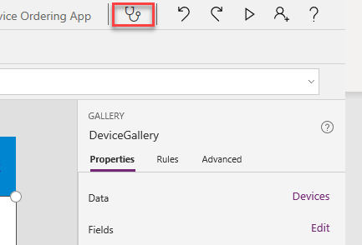
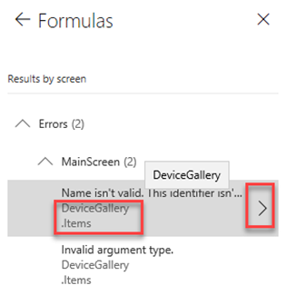
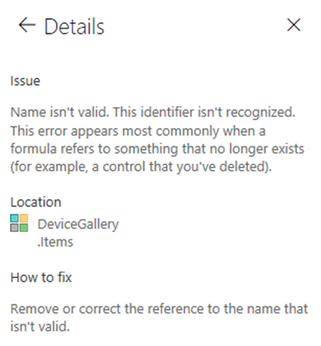
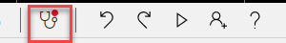
Using App checker
Indicates in real-time if an app contains errors
Clicking on the item will take you to that formula
Clicking on the > on the item will take you to the details of the error
No Errors
Errors Detected
This tool also finds potential accessibility issues and explains why each might be a potential problem
Notes:
We added these extra to expand for exam coverage
App Checker in realtime indicates there are errors
Clicking on the item will take you to that formula
Clicking on the > on the item will take you to the details of the error

Slide 48
Variables
Global variables:
App wide scope
Primary function: Set(CurrentName,”Julie”)
Context variables:
Local screen scope (the screen’s “context”)
Pass values to a screen
Primary functions: Navigate, UpdateContext
E.g. UpdateContext({Current Total:CurrentTotal+ThisItem. Price})
Collections:
App wide scope
Tables only
Primary functions: Collect, Clear, ClearCollect, Update, Remove
Can be saved to the local device with SaveData, LoadData
Notes:
More information on Variables: https://docs.microsoft.com/en-us/powerapps/maker/canvas-apps/working-with-variables

Slide 49
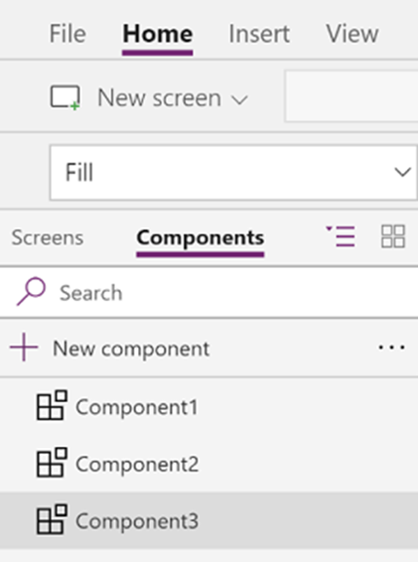
Components
Reusable building blocks
Can be used multiple times
Custom properties define interface with hosting screen
Import and export components
Notes:
Components are reusable building blocks for canvas apps so that app makers can create custom controls to use inside an app, or across app using component library. Components can use advanced features, such as custom properties and enable complex capabilities.
Components are useful in building larger apps that have similar control patterns. If you update a component definition inside the app, all instances in the app reflect your changes. Components also reduce duplication of efforts by eliminating the need to copy/paste controls and improve performance.
Components also help create collaborative development and standardizes look-and-feel in an organization when you use a component library.

Slide 50
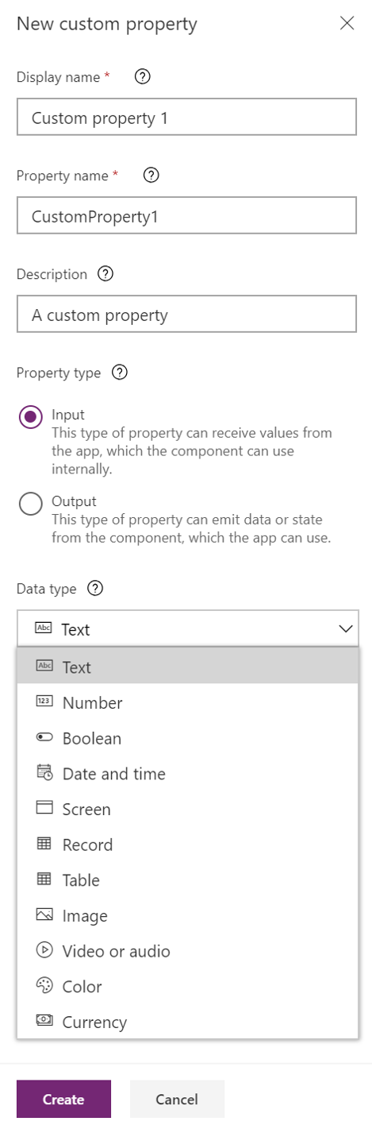
Component custom properties
Can be Input or Output
Default value is assigned based on data type
Notes:
Potential Instructor demo: https://docs.microsoft.com/en-us/powerapps/maker/canvas-apps/create-component#create-an-example-component

Slide 51
Demo: Create components
Demo
Notes:
https://docs.microsoft.com/en-us/powerapps/maker/canvas-apps/create-component#create-an-example-component

Slide 52
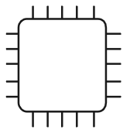
Offline-capable canvas apps
Notes:
Mobile users often need to be productive even when they have limited or no connectivity. When you build a canvas app, you can perform these tasks:
Open Power Apps Mobile and run apps when offline.
Determine when an app is offline, online, or in a metered connection by using the Connection signal object.
Use collections and leverage the LoadData and SaveData functions for basic data storage when offline.

Slide 53
Limitations
LoadData and SaveData combine to form a simple mechanism to store small amounts of data on a local device. By using these functions, you can add simple offline capabilities to your app.
Notes:
These functions are limited by the amount of available app memory because they operate on an in-memory collection. Available memory can vary depending on the device, the operating system, the memory that Power Apps Mobile uses, and the complexity of the app in terms of screens and controls. If you store more than a few megabytes of data, test your app with expected scenarios on the devices on which you expect it to run. You'll generally have 30-70 megabytes of available memory.
The functions also don't automatically resolve merge conflicts when a device comes online. Configuration on what data is saved and how to handle reconnection is up to the maker when writing expressions.
Potential demo: https://docs.microsoft.com/en-us/powerapps/maker/canvas-apps/offline-apps

Slide 54
Document and test your Power Apps application
Notes:
Link: https://docs.microsoft.com/en-us/learn/modules/use-documentation/

Slide 55
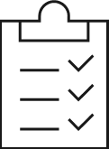
Create test plans

Slide 56
Create test plans
Unit testing – Smallest component of testing, a single unit of measure. Often this is thought to be a developer's job
Quality assurance testing – Someone independently tests the task by reviewing the expectation against the work performed
Performance testing (sometimes also referred to as load testing) – Performance or load testing is most often done using external tools
Integration testing – Did the systems we integrated with perform as expected?
User acceptance testing – This is an opportunity to have direct feedback from the actual users of the system being built
Notes:
There are many types of testing that you should consider in your deployment planning. Each of these can be done either casually, or very formally with a well-documented process to follow. Often in different deployments these will have slightly different expectations. Some testing options are manual (user adoption testing), and some are automated (load testing).
Unit testing- this is the smallest component of testing, a single unit of measure. Often this is thought to be a developer's job. However, every person on a project should include this in their work. An example of unit testing could be: You are given a requirement to add a calculated field to a form. Before you advance the task to the testing team you would confirm the field was on the form as expected and test that the calculation was as expected.
Quality assurance testing- sometimes called QA, this is when someone independently tests the task by reviewing the expectation against the work performed. Often there will be testing of the smallest components, such as the units mentioned above and also testing of a full end-to-end user story.
Performance testing (sometimes also referred to as load testing)- there are many things that can be configured that will have an impact on system performance. Sometimes the number of concurrent users affects expected performance (load); sometimes it's the combined actions of these users, and sometimes an individual user could experience problems such as a slow-loading form that has too many sub-grids. Integrations with other systems might also affect performance. Performance or load testing is most often done using external tools.
Integration testing- did the systems we integrated with perform as expected? Did we introduce unnecessary dependencies?
User acceptance testing- this is an opportunity to have direct feedback from the actual users of the system being built. User acceptance testing (hopefully) confirms the system built is the system users need.
Regardless of the exact type or plan you are using; the following considerations should be included.

Slide 57
Testing plans
Environment
Security
Dependencies
Solution Awareness
Resources
Notes:
A testing plan is an important scoping document in your project plan to communicate what will and will not be tested and necessary considerations for success. The testing plan is designed to be carried out by a technical resource to catch bugs before user acceptance testing.
At a minimum, a test plan should provide a means to test each business requirement for the project. This gives the opportunity to show that each requirement was accommodated and accomplished. When there are issues in the future, a testing plan is a helpful reference of what was tested based on understandings at the time and what may be outside the original scope. The plan needs to define the level of detail to be tested, and the process for solving and retesting any issues found.

Slide 58
Test plan components
Schedule risks:
Environmental needs
Features Tested
Testing Items
Testing Schedule
Process or fixing and Retesting failed test items
Notes:
Related Business Requirement
Steps to test
Expected result
Item pass or fail
Time and date tested
Tester name
Testing Notes
Testing Schedule
Dependencies
Timelines
Schedule risks
Dependencies
Timelines
Schedule risks
Process for fixing and retesting failed test items
A good test plan describes the intention and scope of testing, guides the technical review process and supports a smooth rollout of functionality. A test plan should proceed user acceptance testing and have a means for tracking needed changes before rollout.

Slide 59
User interface testing

Slide 60
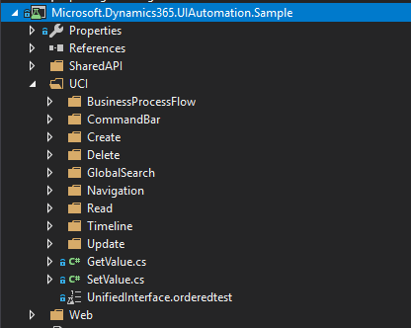
Sample tests
Over 100 standard tests for the Web Client and over 50 tests for the Unified Interface are available
Notes:
Over 100 standard tests for the Web Client and over 50 tests for the Unified Interface are available. The sample test bank covers create, retrieve, update, and delete scenarios for multiple entities including contacts, opportunities, accounts, leads, and cases. This provides you the ability to easily run and start creating customized tests using the test bank as your initial code base. You can easily access the pre-defined tests within each of the specific functional areas you are testing.

Slide 61
Performance optimization

Slide 62
Performance optimization
When analyzing performance of Common Data Service, it is important to understand areas affecting the performance of an app
Notes:
When analyzing performance of Common Data Service, it is important to understand areas affecting the performance of an app.

Slide 63
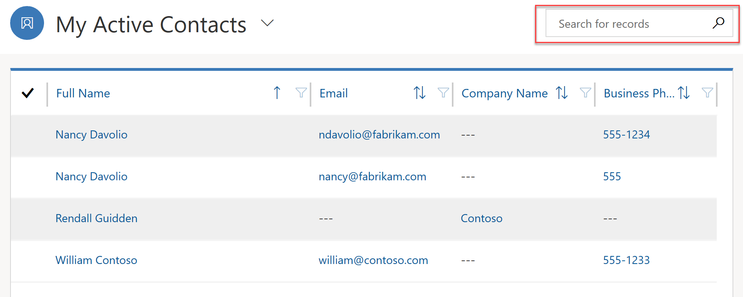
App performance
Design of the app itself can greatly affect performance
Notes:
Design of the app itself can greatly affect performance. One of the strengths of the Power platform is ability to quickly build robust small apps targeting specific users and specific functionality. Instead of a monolithic app that is more likely to suffer from performance issues you now have the ability to design several separate apps. This separation ensures that each app can be analyzed and tuned independently without too much impact on the others.
Design techniques for individual components may also affect performance of an app.
To improve form performance, design them so that only the information essential for the users is included. If information required depends on the user's role, consider creating multiple forms instead of one monolithic form that includes every single field. Hiding tabs and sections that are not required to be immediately visible can also improve form responsiveness and performance.
One of the most common sources of performance issues on the forms is custom scripts added by developers. Good collaboration within the team is a key to identify and resolve any performance bottlenecks introduced during the development.
To improve performance of the entity views, limit the number of columns displayed only to those required by the business. As often the case, it's a balance between the responsiveness and bringing enough information to improve usability of the view.
Customize your views so that they bring back an actionable number of records. For example, Active Contacts view may contain hundreds of thousands of records while My Active Contacts will limit that view only to the contacts that are owned by the user. At the same time consider limiting the number of records per page so that the views return much more quickly.
Optimizing the quick search view only to include columns that makes sense to search will make a noticeable performance impact on searches within the views.

Slide 64
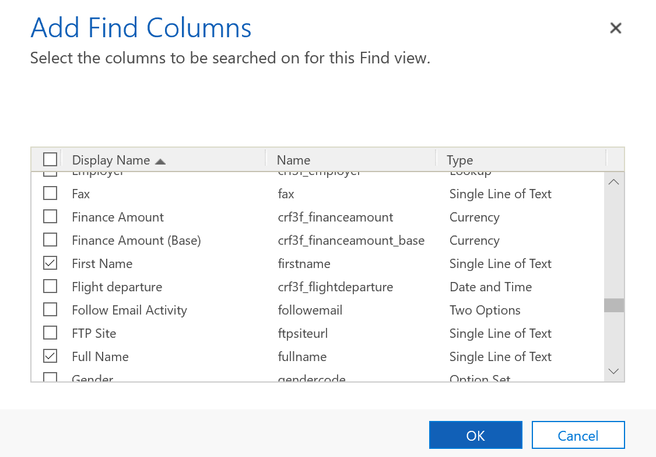
App performance
When a user searches for records within a view, Common Data Service performs a query that searches only predefined fields
Notes:
When a user searches for records within a view, Common Data Service performs a query that searches only predefined fields. Which fields are searched is defined by the Find Columns settings in the system Quick View.
The fewer number of columns that are selected, the faster quick search will be. Balance the number of find columns with the effectiveness of the search.
The primary source of performance issues in canvas apps are poorly designed data access, excessive or suboptimal formula use, and overly complex user interface.
Apps will perform poorly when most of the heavy lifting is done on the client and not on the server. Erroneous choice of how to query your data may lead to performance issues. Understanding delegationin canvas apps is the key to improving you app performance when it comes to data access.
There are some canvas apps features that you would want to consider when optimizing your app start performance by using Concurrent function to load data from multiple sources concurrently.
Another aspect that can affect performance is the number of screens and controls used in your app. Minimizing the number of controls and reducing complexity of the controls used can help boost your app performance. It will improve the performance while authoring the app as well. There are strategies to optimizing the number of controls used in your app. For example, you can use a gallery control instead of a Canvas/Data Cards when the data displayed is uniform or vary only slightly. Gallery can be powerful in reducing complexity, making your app easier to maintain.
There are other optimizations techniques available, make sure that canvas apps developers familiarize themselves with detailed documentation.
Real-time workflows can be very effective but, if designed poorly, will affect the performance of the most common operations such as creating or updating a record. Consider converting poorly performing or long running workflows to background ones where the impact on the system will be smaller.
Background workflows create a log record when an instance of the workflow is executed. The default setting is to delete log entries for successfully executed workflows. If this setting is changed to keep the entries, jobs log will grow and may reach the point where it affects performance of the asynchronous services. Only use this flag for troubleshooting and avoid leaving it on in production.
Custom extensions such as plugins are the common source of the performance issues. Work with developers to identify and resolve those.

Slide 65
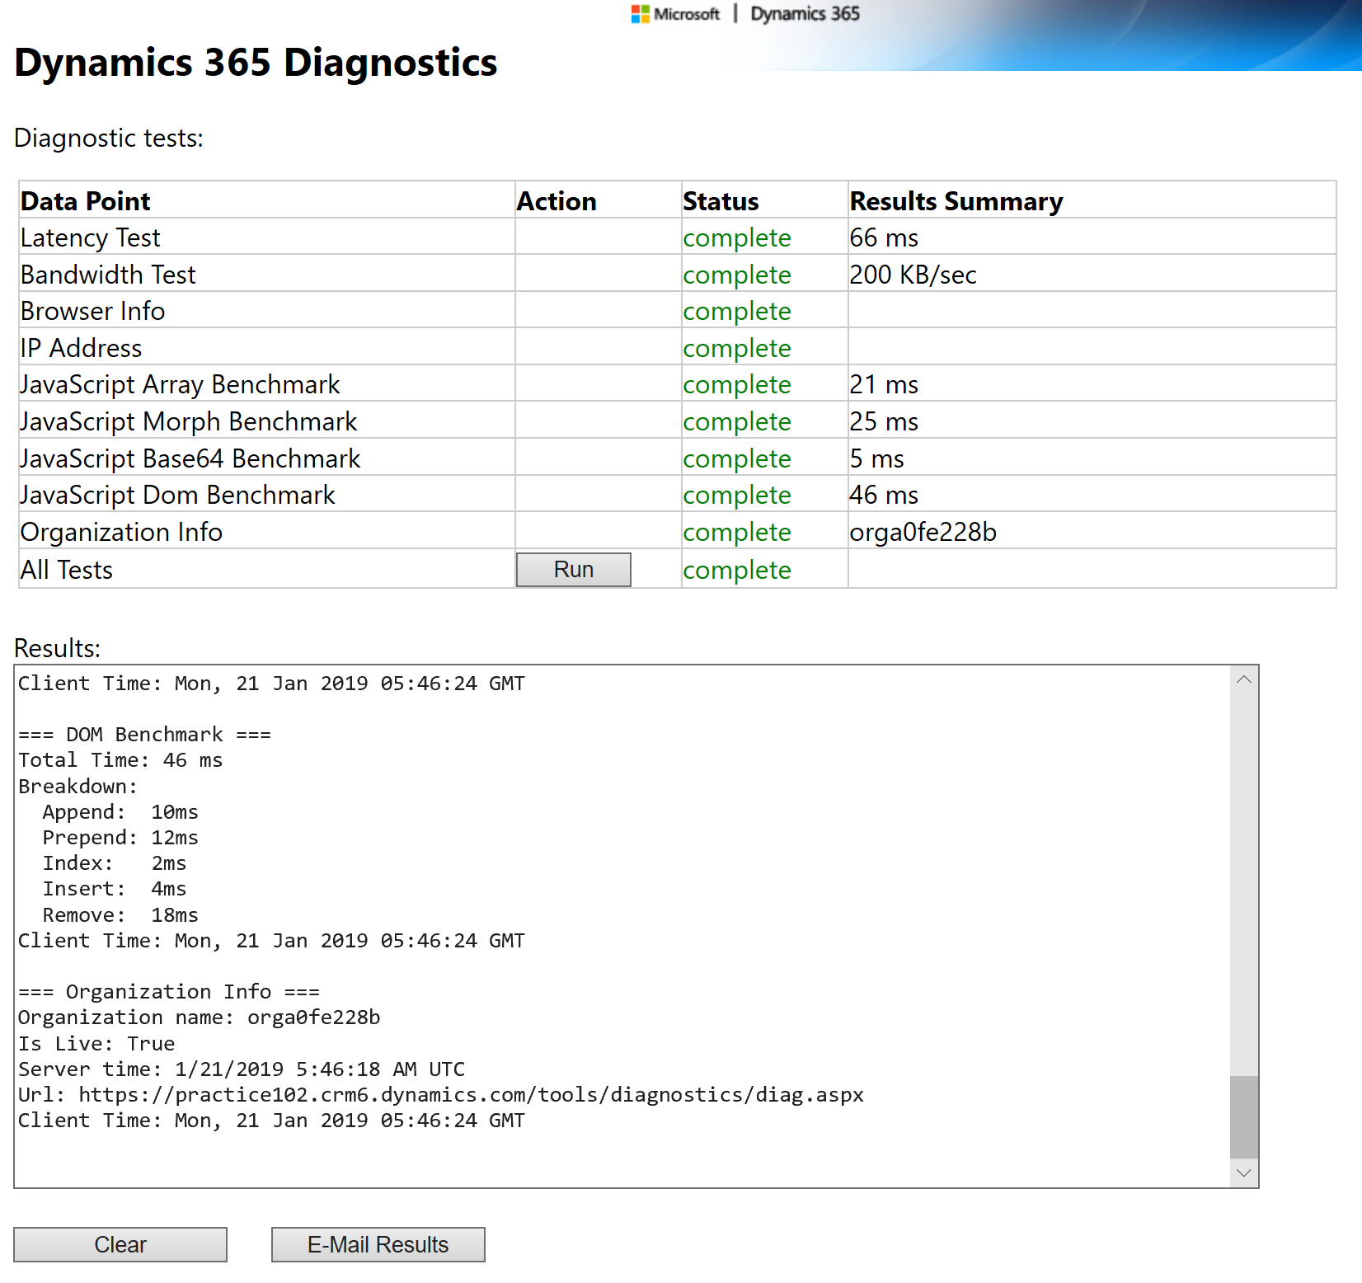
Dynamics 365 Diagnostics
There are two primary network characteristics affecting the performance: Network bandwidth and latency
Notes:
There are two primary network characteristics affecting the performance: network bandwidth and latency. Identify if these may impact your app performance, by using the Dynamics 365 Diagnostics tool that is available at https://<myorg>.crm.dynamics.com/tools/diagnostics/diag.aspx where <myorg>.crm.dynamics.com is the URL of your Dynamics 365 organization.
After opening the page and pressing Run, the report will become available that will assist your network team in detecting and resolving the issues. The statistic includes some browser benchmarks that may be useful in identifying if browser performance is an issue.

Slide 66
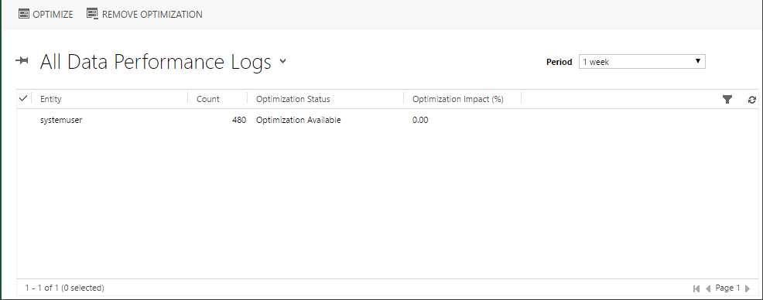
Data Performance Logs
You can analyze and optimize query performance using the Data Performance view, which provides an aggregated list of entities with long-running queries
Notes:
You can analyze and optimize query performance using the Data Performance view, which provides an aggregated list of entities with long-running queries. A long running query is defined as a query that takes three seconds or longer to complete. Typical examples of a component that can have a long running query is a plug-in with custom FetchXML or a sub-grid or view.
You can access Data Performance Logs via Settings -> Administration -> Data Performance.
If one or more long running entity queries are detected, log items are displayed in the view. You can use the Optimize command to apply optimizations to the selected query.
[!Note] With the most recent advances in Azure SQL database self-tuning capabilities you may no longer see any long running queries reported in the Data Performance view. Slow queries are automatically detected and optimized at the database level.

Slide 67
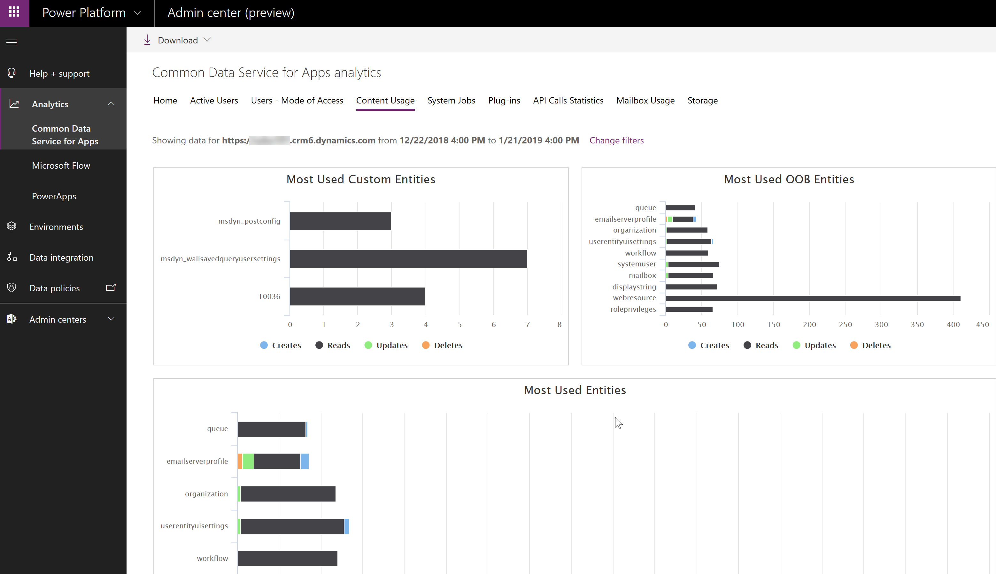
Analytics
Common Data Service analytics are available via the Power platform admin center https://aka.ms/ppac
Notes:
Common Data Service analytics are available via the Power platform admin center https://aka.ms/ppac. Various statistics can help identifying potential areas for deeper performance analysis.
The Content Usage tab contains information about most used out-of-the-box and custom entities. Identifying the most used entities helps concentrate the optimization efforts on the parts of the app that matter.

Slide 68
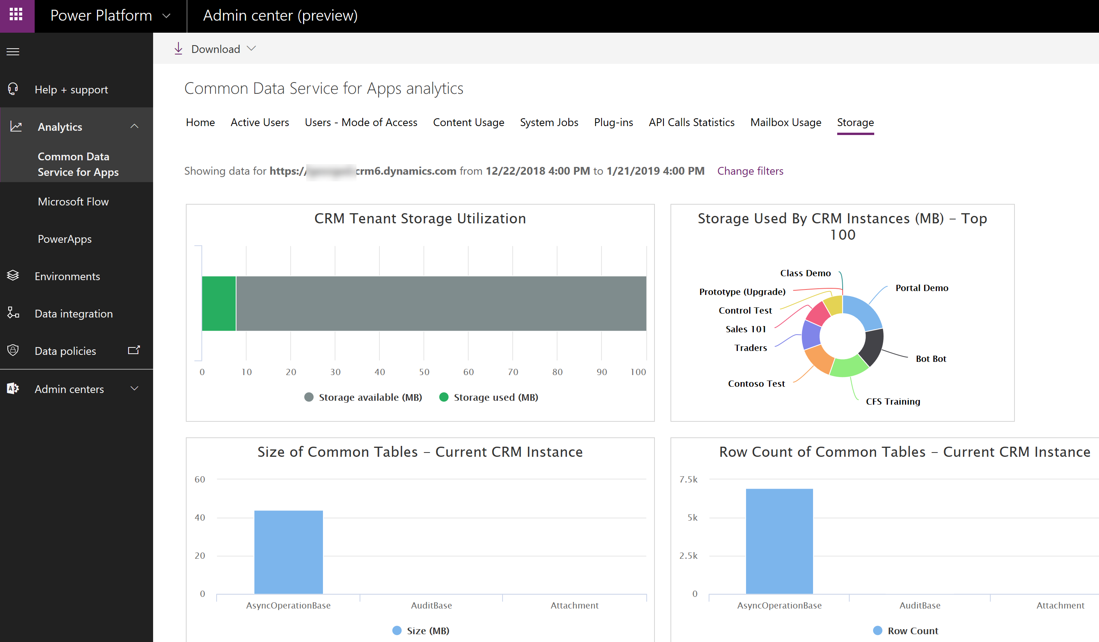
Analytics
The Storage tab provides a number of storage statistics across all of your tenant instances as well as breakdown of the storage within the selected instance
Notes:
The Storage tab provides a number of storage statistics across all of your tenant instances as well as breakdown of the storage within the selected instance.
This can help identify entities with excessive storage use that would be a primary target for further performance investigations.
Other statistics are also available that may be useful. Plug-ins statistics can assist in identifying troublesome plugins, for example those with excessive average execution time.
Power Apps Analytics help with performance analysis by providing detailed statistics on Service Performance across various connectors used in your app.
Additional information such as overall app usage, location statistics, or errors seen by end users can be extracted from other tabs. While not directly performance related, this information can be useful in pinpointing overall problematic areas that may be caused by poor app performance such as specific region, specific app, etc.

Slide 69
Documentation and the customer

Slide 70
Documentation and the customer
Types of Documentation:
Definitions
Architecture and Design
Technical specifications
End-User
Internal Marketing
Chang log
Notes:
Good documentation is key to the successful rollout of a Power Apps application. This video provides some best practices and suggestions on what to document for an app.
[!VIDEO https://www.microsoft.com/videoplayer/embed/RWs1Uz]

